Slide 1


Regional
Economic Outlook
Winter 2020
February 5, 2020
Robert F. Salvino, Ph.D.
Coastal Carolina University

Slide 2
Executive Summary
The Economic Outlook Board of the Waccamaw Council of Governments met on February 5, 2020 to review the latest quarterly economic indicators for the Grand Strand and surrounding region.
National Economy
Regional Insight
2.1% GDP growth 2019, 3rd and 4th quarters.
U.S. unemployment down to 3.5%, compared to 4.0% one year ago.
Coronavirus outbreak temporarily shaking up markets but should not prove enduring.
2019Q4 from 2019Q4 for Horry Co.:
Unemployment: 3.2% (-0.8)
Employment: 147,558 (+6.5%)
Occupancy: 49.1% (+7.0)
Retail Sales: 2.7 billion (+0.6%)
Please see remaining slides…

Slide 3
Helpful Notes and Reminders
Tourism Quarters: To reflect the importance of the seasons, offset by 1 month so that Q1 (Winter) is December, January, February, Q2 (Spring) is March, April, May, Q3 (Summer) is June, July, August and Q4 (Fall) is September, October, November.
National data is based on normal calendar year, e.g. GDP 1st quarter is for January, February, March.
All data reflect the period of business activity, unless otherwise noted.
Receipts and collections of tax revenue by SC DOR may not coincide with period of business activity, e.g. retail sales business activity shows quarterly spikes; however the actual business activity may not resemble this periodic behavior.
Reported and estimated changes in rate measures are reported as unit changes rather than percent changes, for example the unemployment rate movement from 6% to 6.5% is shown as a movement of one-half of a point (0.5).

Slide 4
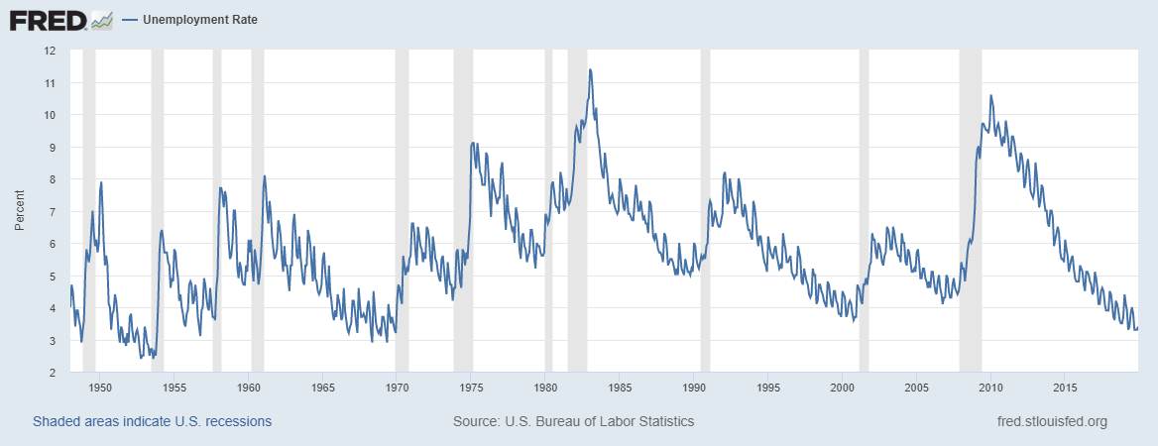
U.S. Unemployment Historical
1960’s expansion:
Top PIT rate lowered:
91% to 70%
Post-war and Korean Conflict: 1950-1953
Lowest on record was
During WWII: 1.2%

Slide 5
Source: U.S. Census

Slide 6
Source: U.S. Bureau of Economic Analysis

Slide 7
Source: U.S. Bureau of Economic Analysis

Slide 8
Annualized Real GDP Growth (%)
Source: U.S. Department of Commerce: Bureau of Economic Analysis

Slide 9
MYR Airport Deplanements (Thousands)
Source: Myrtle Beach International Airport

Slide 10
Hotel-Condotel-Campground Occupancy Rate
Source: Clay Brittain Jr. Center for Resort Tourism

Slide 11
Hotel-Condotel-Campground Average Daily Rate
Source: Clay Brittain Jr. Center for Resort Tourism

Slide 12
Accommodations Tax Revenue ($Millions)
Source: SC Department of Revenue

Slide 13
Regional Single Family Permits
Source: HUD State of the Cities Data System

Slide 14
Georgetown Retail Sales ($ Millions)
Source: SC Department of Revenue

Slide 15
Horry Retail Sales ($ Millions)
Source: SC Department of Revenue

Slide 16
Williamsburg Retail Sales ($ Millions)
Source: SC Department of Revenue

Slide 17
Georgetown Employment (Thousands)
Source: Local Area Unemployment Statistics, Bureau of Labor Statistics

Slide 18
Horry Employment (Thousands)
Source: Local Area Unemployment Statistics, Bureau of Labor Statistics

Slide 19
Williamsburg Employment (Thousands)
Source: Local Area Unemployment Statistics, Bureau of Labor Statistics

Slide 20
Georgetown Unemployment Rate
Source: Local Area Unemployment Statistics, Bureau of Labor Statistics

Slide 21
Horry Unemployment Rate
Source: Local Area Unemployment Statistics, Bureau of Labor Statistics

Slide 22
Williamsburg Unemployment Rate
Source: Local Area Unemployment Statistics, Bureau of Labor Statistics

